Slide 1








MOVIE DATASET ANALYSIS

Slide 2








Our Team
2021998486
2021999675

Slide 3









Abstract
The entertainment industry has witnessed rapid growth with the number of movies across genres and platforms. In this context, conducting a comprehensive analysis of a movie dataset can offer valuable insights into various aspects of filmmaking, distribution, and audience preferences. This study aims to explore such insights by performing a detailed analysis of a diverse movie dataset. The dataset comprises a vast collection of information related to movies, including attributes such as release year, genre, director, cast, budget, box office earnings, and audience ratings. Analysis can be performed using some python libraries like NumPy, Pandas, Matplotlib, seaborn and scikit-learn to obtain useful information.

Slide 4





Content
Introduction
System requirements
Architecture of the analysis
Project Goals
Libraries and dataset
Project result
Advantages of our project
Conclusion
References

Slide 5

Introduction
Step into the captivating world of cinema with our project, "Discovering Cinema: An Analysis of Movie Data." Using a movie dataset, we uncover the evolution of films, revealing trends and stories that shape the industry. From timeless classics to today's blockbusters, our data analysis uncovers the influence of directors, the sway of genres, and audience preferences. This exploration not only enlightens enthusiasts and filmmakers but also showcases the potential of data in understanding cinematic intricacies. Join us on a journey to unravel the past, make sense of the present, and foresee the future of the silver screen.

Slide 6

System Requirement
Software specifications
Language used: python
Operating system: windows 11
Hardware specifications:
Hard disk: 512 GB
Processor: Ryzen
Interpreter: Jupiter notebook (Anaconda)

Slide 7
Architecture of the analysis
Importing python libraries for analysis
Finding and reading the dataset
Data Cleaning
Data filtering
Grouping the data with different aspects of variables
Sorting the Dataset
Aggregation of numeric columns
Data visualization :Visual plotting like histogram , bar-plots and pie-plots on various numerical columns.
Relations between the numerical columns using correlation
heatmaps

Slide 8
Project Goals
We want to answer questions like:
What is the distribution of movie ratings ?
How does the budget vary across top 20 different genres ?
What is the distribution of movie budgets ?
What is the trend of movie releases over the years ?
How does the revenue vary across top 20 different genres ?
Which genres tends to have the highest budget and revenue?
What are the top 15 highest-grossing movies ?
What is the distribution of movie durations ?
How has the movie production trend evolved over the years for the top 5 genres ?
What is the distribution of movie budgets for the top 5 genres ?
What does the correlation heatmap of the movie dataset reveal about the relationships between different numerical attributes?
Displaying different movie trends in budget, revenue, popularity, runtime, and user ratings in the movie dataset over time .
How does the movie rating vary by director's experience (number of movies directed)?
Are there any trends in movie release months?
What is the relationship between budget and revenue for the top 10 genres?
What is the distribution of movie durations for each genre?
How does the popularity vary with movie revenue?

Slide 9
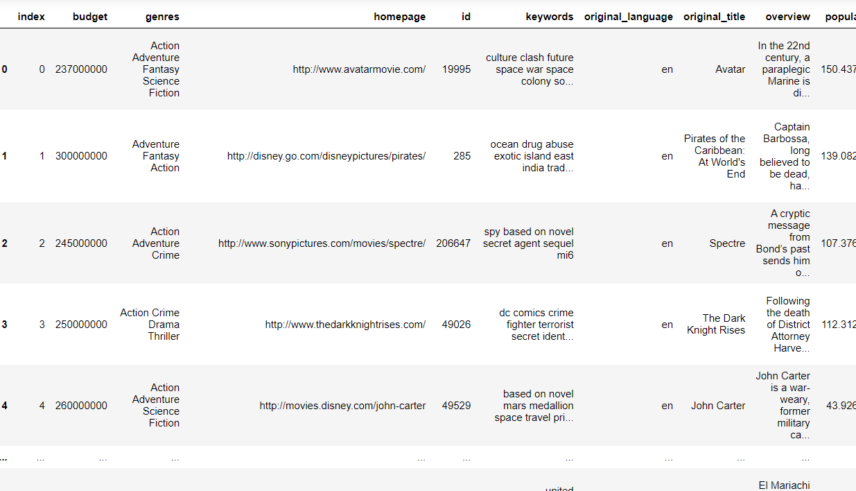
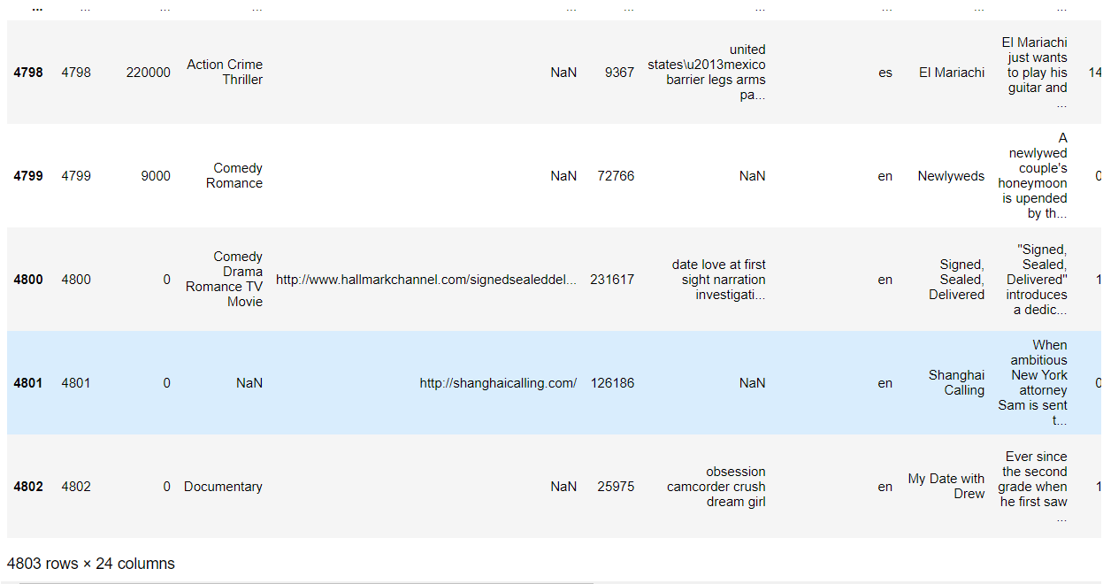
Libraries
* NumPy
* Pandas
* Matplotlib
* Seaborn
* Scikit-Learn
Dataset

Slide 10
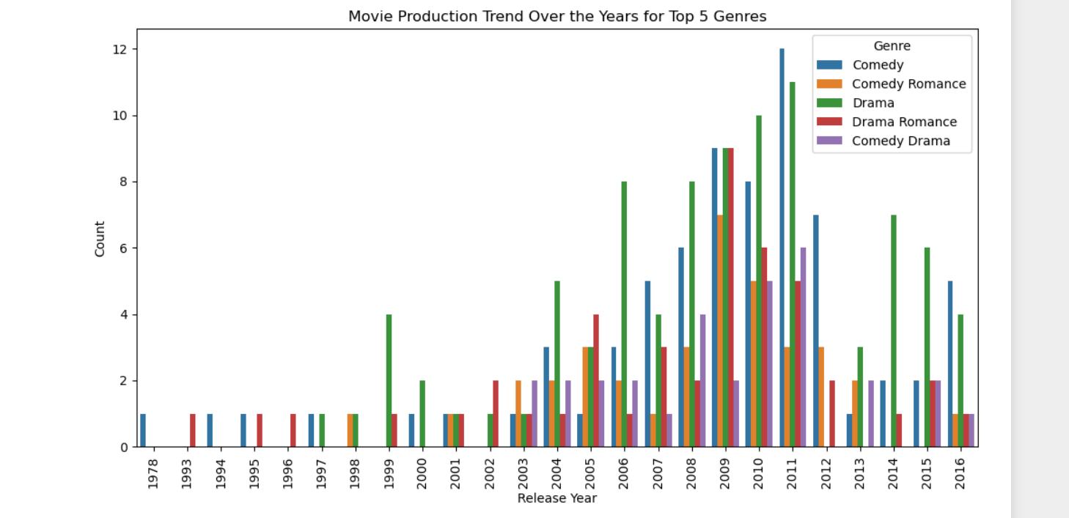
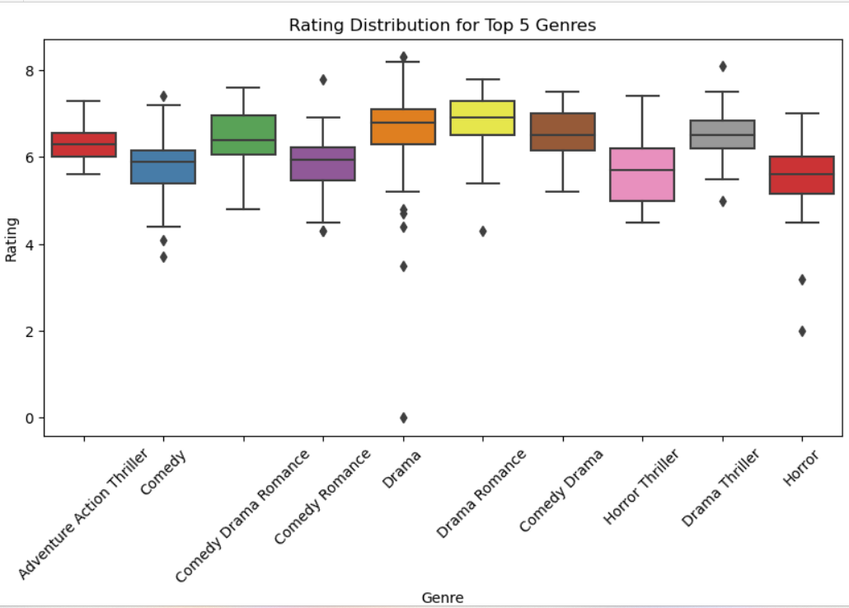
Result

Slide 11
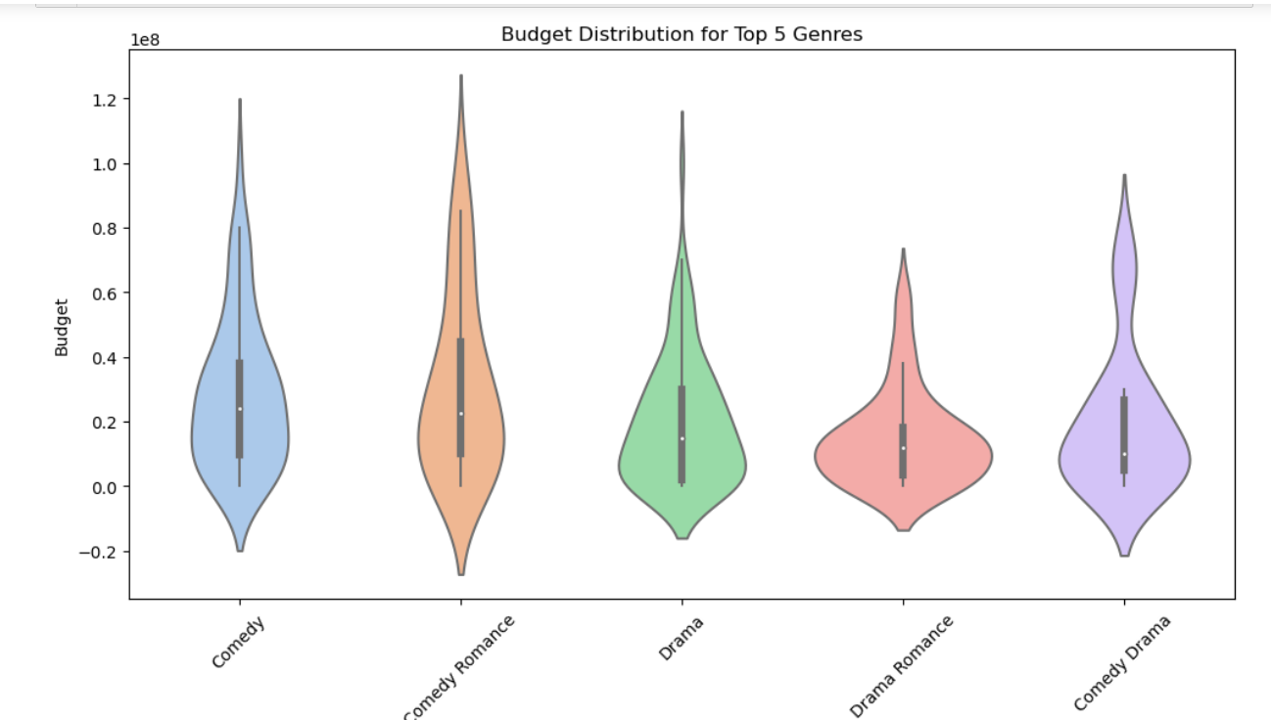
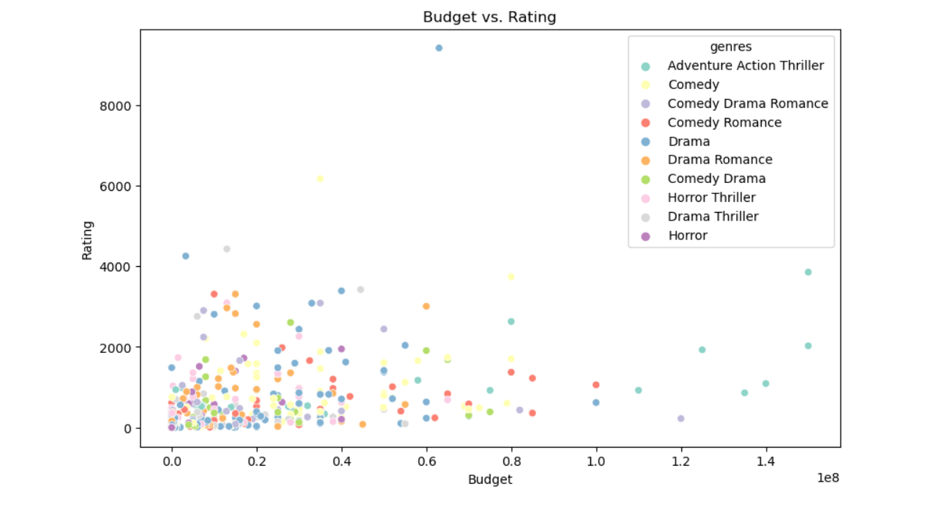
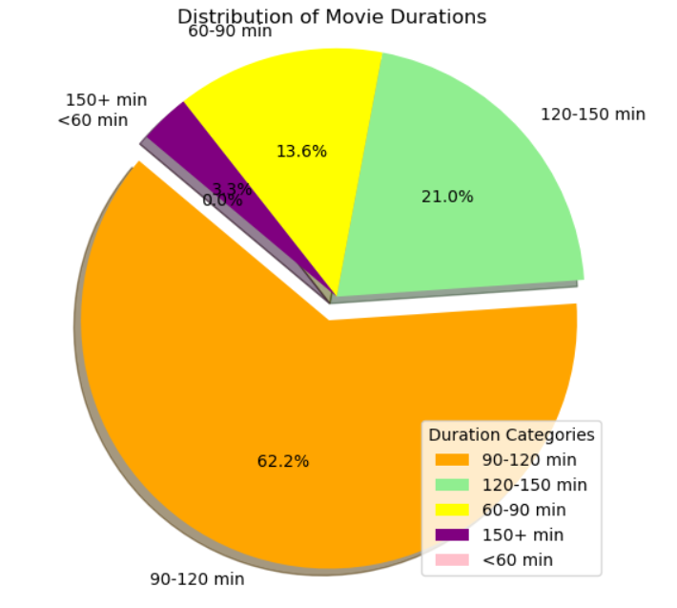
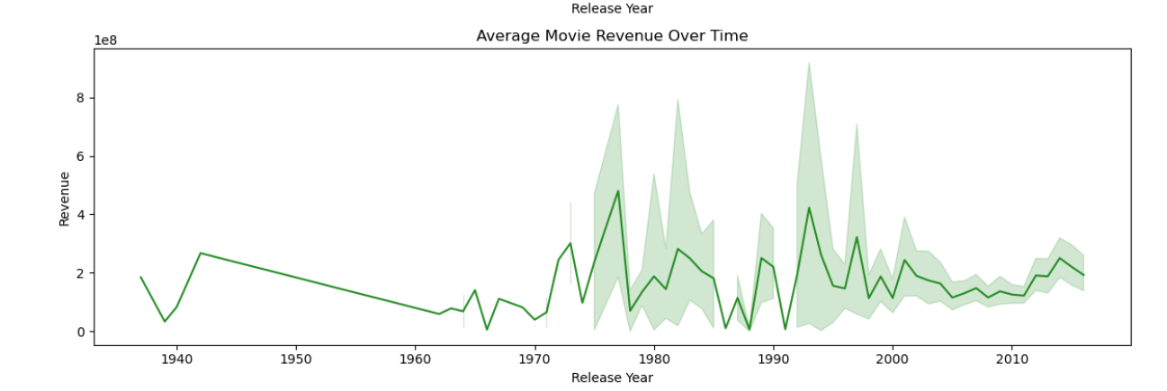

Slide 12

Advantages of our Project
Informed Decision with insights
Budget Efficiency
Audience Preferences
Director Selection
Casting Success
Global Strategies
Industry Trends
Marketing Effectiveness
Learning from Mistakes
Creative Synergy

Slide 13


Conclusion
Here are the some of the results we extracted from the analysis:
We analyzed a dataset that contains information about movies dataset from 1987 -2016. It contains 4803 movie entries.
We check the dataset if their any null values or missing values and duplicates by using data cleaning .
We fill some null and other values in place of them using data cleaning and prepare a clean data. Afterward we filter ,grouped and sort the data for future analysis.
We analyse the data and show the insights of data by data visualization .
Dramas are mostly viewed genres followed by comedy .
Most of the movies were released in between 2000s to 2010s and mostly were released in month of September.
Avatar is highest grossing movies followed by titanic is second highest.
Movies with a duration of 90-120 minutes constitute the largest portion, making up 62.2% of the dataset and the second most common duration category is 120-150 minutes, accounting for 21%.
The count plot demonstrates that some genres have experienced variations in production from year to year, with certain years witnessing higher production counts for specific genres.
There is a positive correlation between popularity and revenue across these genres. It suggests that movies with higher revenues tend to be more popular.

Slide 14




Reference
Kaggle www.kaggle.com
Canva www.canva.com
W3school www.w3schools.com
YouTube www.youtube.com

Slide 15






